Slide 1
Lecture 6
Bivariate Distributions
Marginal Distributions
Independence of two random variables

Slide 2
Example: Education and Monthly Personal Income
Suppose that education level (X) can take values 1=“below college”, 2=“college”, and 3=“above college”. Suppose that monthly personal income (Y) can take values 1=“<2000”, 2=“2000-4999”, 3=“5000-9999”, 4=“>=10000”.
Suppose that in certain population, the probabilities for different combinations of education level and monthly personal income are given by the table below.
  Y
  1 2 3 4
  1 0.2 0.1 0.06 0.04
  X 2 0.09 0.06 0.1 0.15
  3 0.01 0.03 0.08 0.08

Slide 3
Bivariate Distributions
The joint probability distribution of two random variables is called a bivariate distribution.
X and Y have a discrete joint distribution.
  X and Y each has a discrete distribution.
  If both X and Y have a finite number of possible values, then there will be a only finite number of possible values for the pair (X,Y).
  Otherwise, there will be an infinite number of possible values for the pair (X,Y).
Notes:
E.g. Gender (female, male) and education (primary school, middle school, high school, college, above college), education and income.

Slide 4
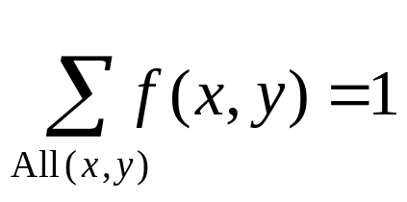
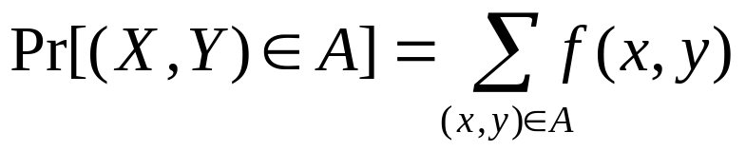
The joint p.f. of X and Y is defined to be
f(x,y)=Pr(X=x and Y=y).
If (x,y) is not one of the possible values of the pair of random variables, then f(x,y)=0.
With all pairs of (x,y) for which f(x,y)>0,
For any subset A of the xy-plane,

Slide 5
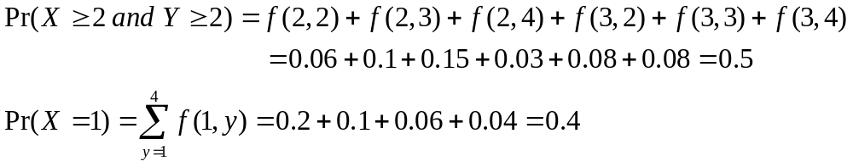
Example: Education and Monthly Personal Income
Suppose that in certain population, the probabilities for different combinations of education level and monthly personal income are given by the table below.
  Y
  1 2 3 4
  1 0.2 0.1 0.06 0.04
  X 2 0.09 0.06 0.1 0.15
  3 0.01 0.03 0.08 0.08

Slide 6
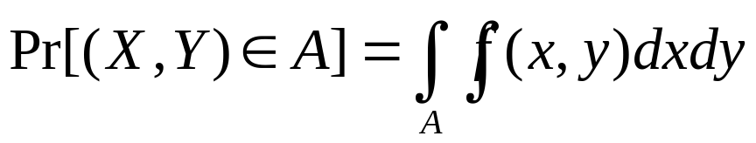
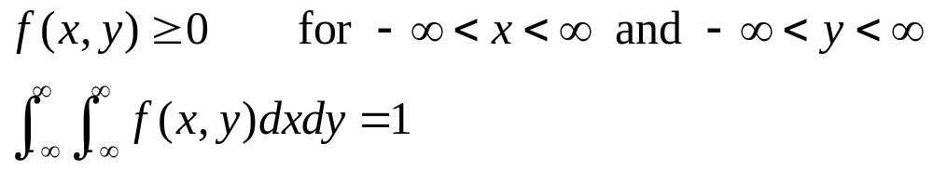
Continuous Joint Distributions
X and Y have a continuous joint distribution if there exists a nonnegative function f, defined over the xy-plane, s.t. for any subset A of the plane,
f is called the joint probability density function of X and Y.

Slide 7
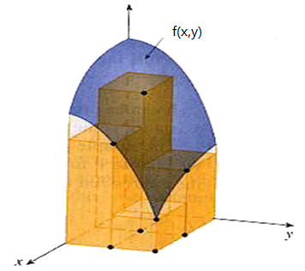
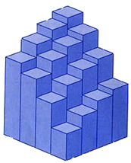
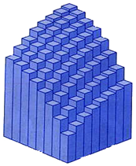
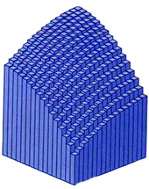
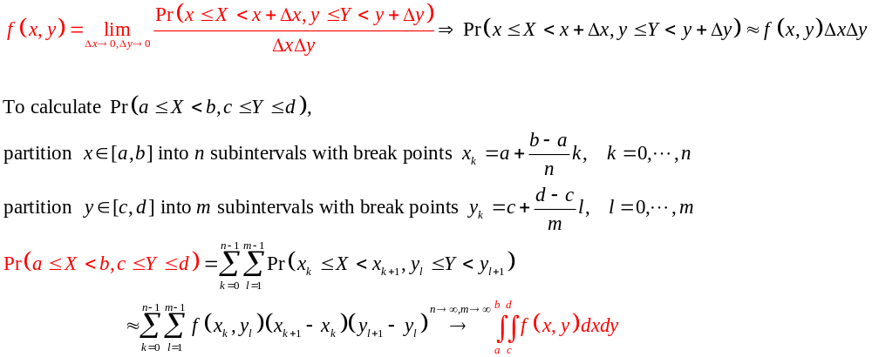
Understanding Joint Probability Density Function

Slide 8
Any individual point, or any infinite sequence of points, in the xy-plane has probability 0.
Any one-dimensional curve in the xy-plane has probability 0.
  The probability that (X,Y) will lie on any specified straight line is 0.
  The probability that (X,Y) will lie on any specified circle is 0.
Notes:
One-dimensional curve has area zero, so the integral of the pdf is 0.

Slide 9
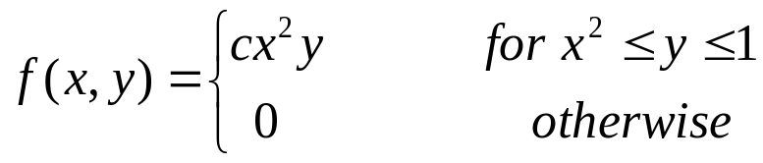
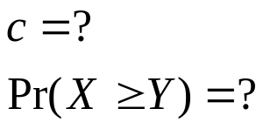
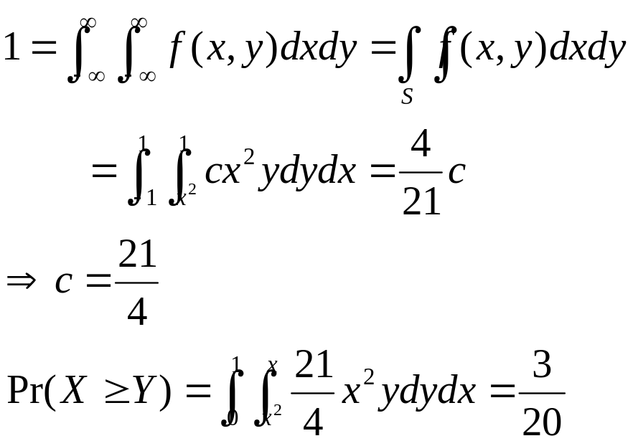
Example: Calculating Probabilities from A Joint p.d.f.
Suppose the joint p.d.f. of X and Y is:
Solution:
Notes:
Normalizing constant again.

Slide 10

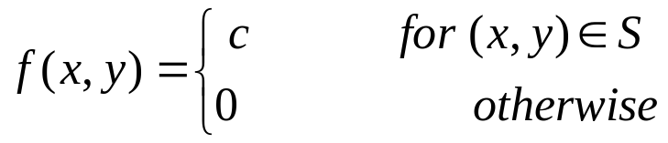
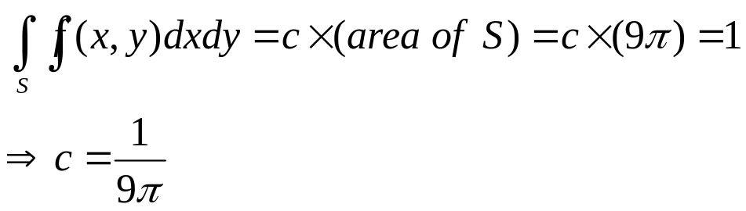
Example: Determining A Joint p.d.f. by Geometric Methods
A point (X,Y) is selected at random from inside the circle . What is the joint p.d.f. of X and Y?
  Let S denote the set of points in the circle
  The joint p.d.f. of X and Y is constant over S and is 0 outside S.
  We must have

Slide 11
Bivariate Distribution Function
The joint distribution function, or joint d.f., of X and Y is defined to be the function F, s.t.
Notes:
What does F(x,y) mean? Draw a graph.

Slide 12

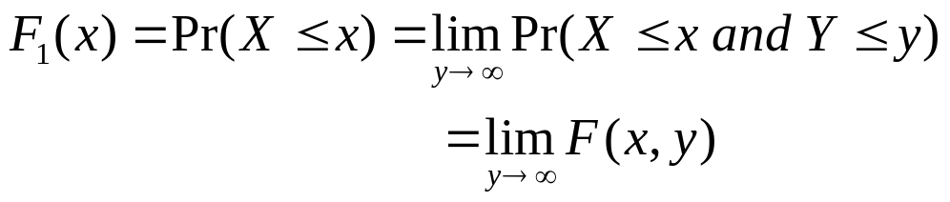

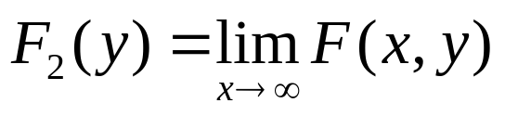
The d.f. F1 of X can be derived from the joint d.f. F as follows, for
If F2 denotes the d.f. of Y, then for
Notes:
Seen from the graph.

Slide 13
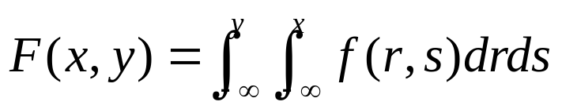
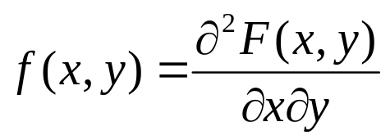
If X and Y have a continuous joint distribution with joint p.d.f. f, then the joint d.f. is
The p.d.f. can be derived from the joint d.f.
at every point (x,y) where this second-order derivative exists.

Slide 14

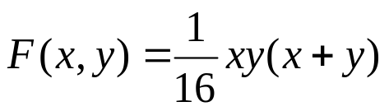
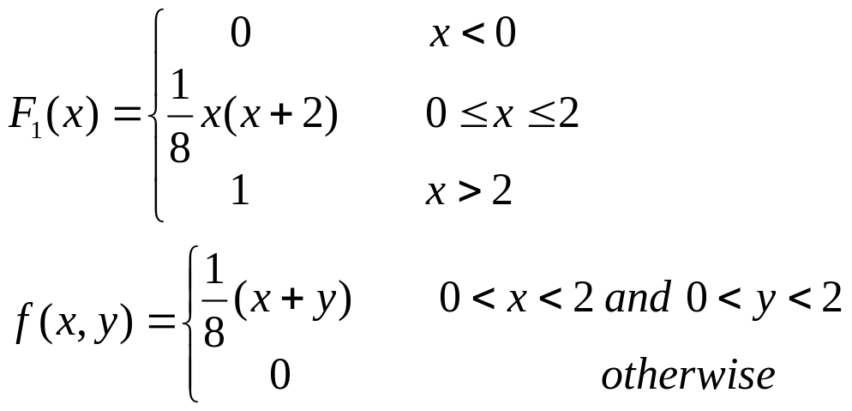
Example: Determining a Joint p.d.f. from a Joint d.f.
The joint d.f. of X and Y, for
is . What is the d.f. F1 of X? What is the joint p.d.f of X and Y?

Slide 15
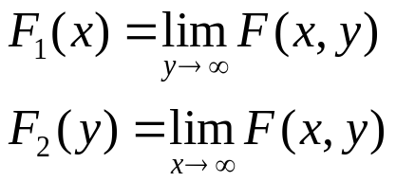
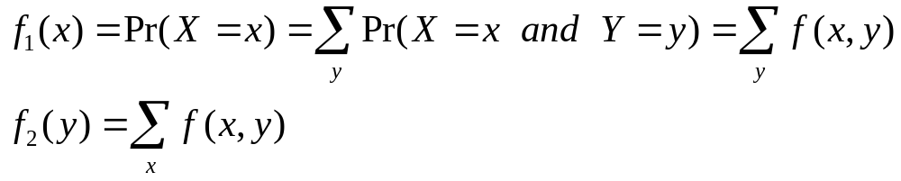
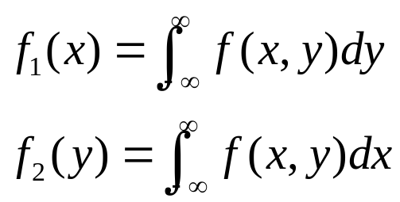
Marginal Distributions
joint d.f. → marginal d.f.
joint p.f. or p.d.f. → marginal p.f. or p.d.f.
  discrete joint distribution:
  continuous joint distribution:

Slide 16







Example: Marginal p.f.
The joint p.f. of education level and monthly personal income is specified as:
  Y
  1 2 3 4
  1 0.2 0.1 0.06 0.04
  X 2 0.09 0.06 0.1 0.15
  3 0.01 0.03 0.08 0.08
→
→
→
→
→
→
→

Slide 17
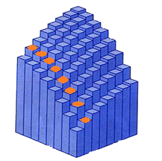
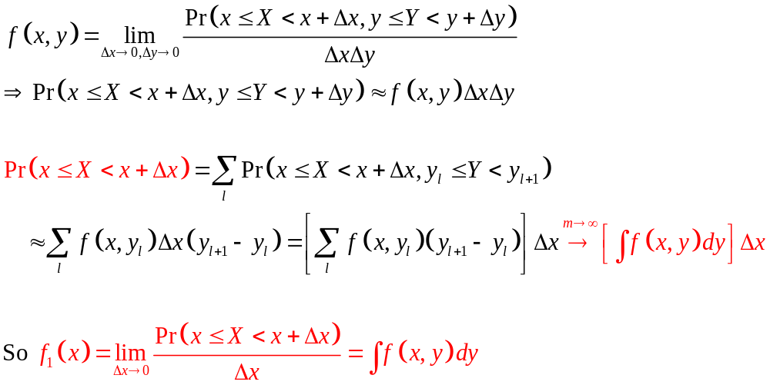
Understanding Marginal p.d.f.

Slide 18
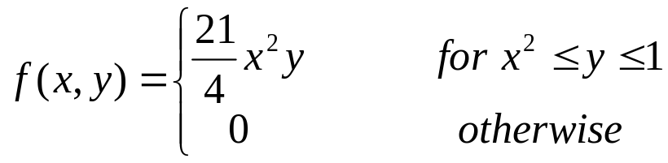

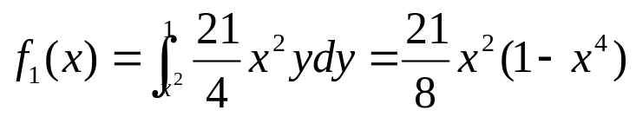

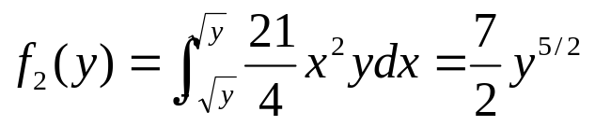
Example: Marginal p.d.f.
Suppose the joint p.d.f. of X and Y is:
  For x<-1 or x>1,
  Otherwise,
  For y<0 or y>1,
  Otherwise,

Slide 19
marginal d.f. → joint d.f. ?
marginal p.f. or p.d.f. → joint p.f. or p.d.f.?
IMPOSSIBLE without further information!
Notes:
If we know the marginal distribution of gender (50% female, 50% male) and the marginal distribution of education. Can we infer the joint distribution of gender and education?

Slide 20
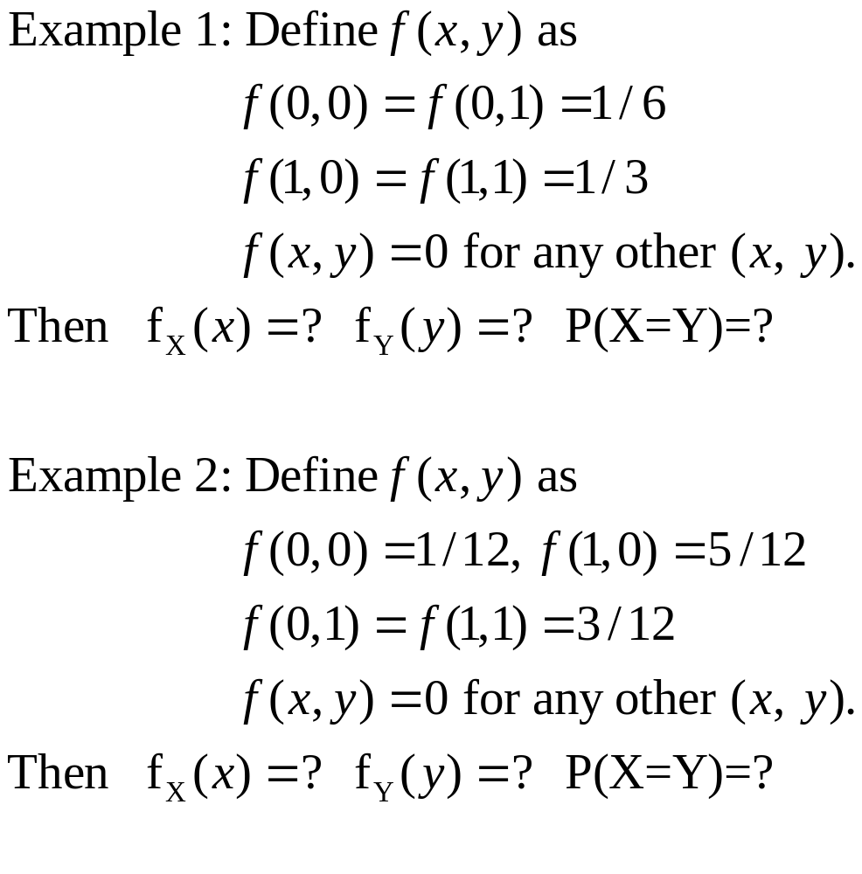

Slide 21
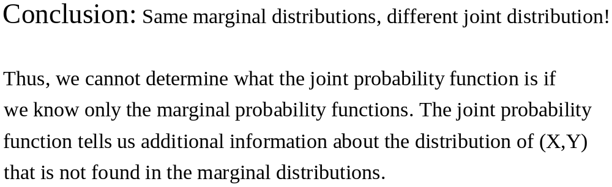

Slide 22
Independent Random Variables
Two random variables X and Y are independent if, for any two sets A and B of real numbers,

Slide 23


X and Y are independent

Slide 24
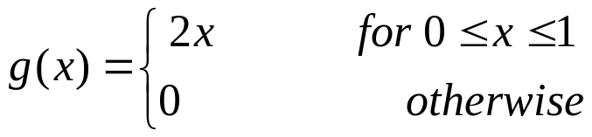

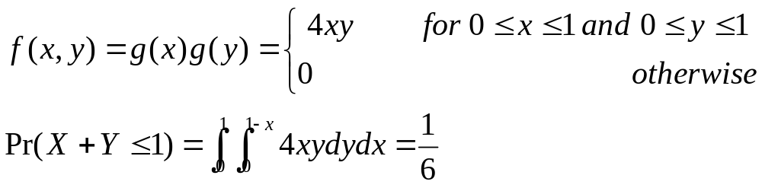
Example
Suppose X and Y independently have the following p.d.f.
Solution:

Slide 25

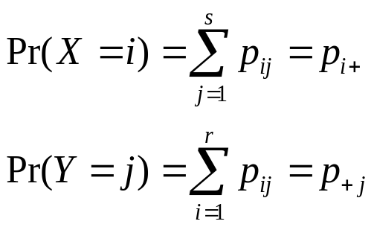

Suppose X and Y have discrete distributions, X can take the values 1,2,...,r, and Y can take the values 1,2,...,s, and
Then,
X and Y are independent

Slide 26







Example
The joint p.f. of X and Y is specified as:
  Y
  1 2 3 4
  1 0.06 0.02 0.04 0.08
  X 2 0.15 0.05 0.10 0.20
  3 0.09 0.03 0.06 0.12
→
→
→
→
→
→
→
Independent!
Independent
The rows are proportional to each other.
The columns are proportional to each other.

